Slide 1
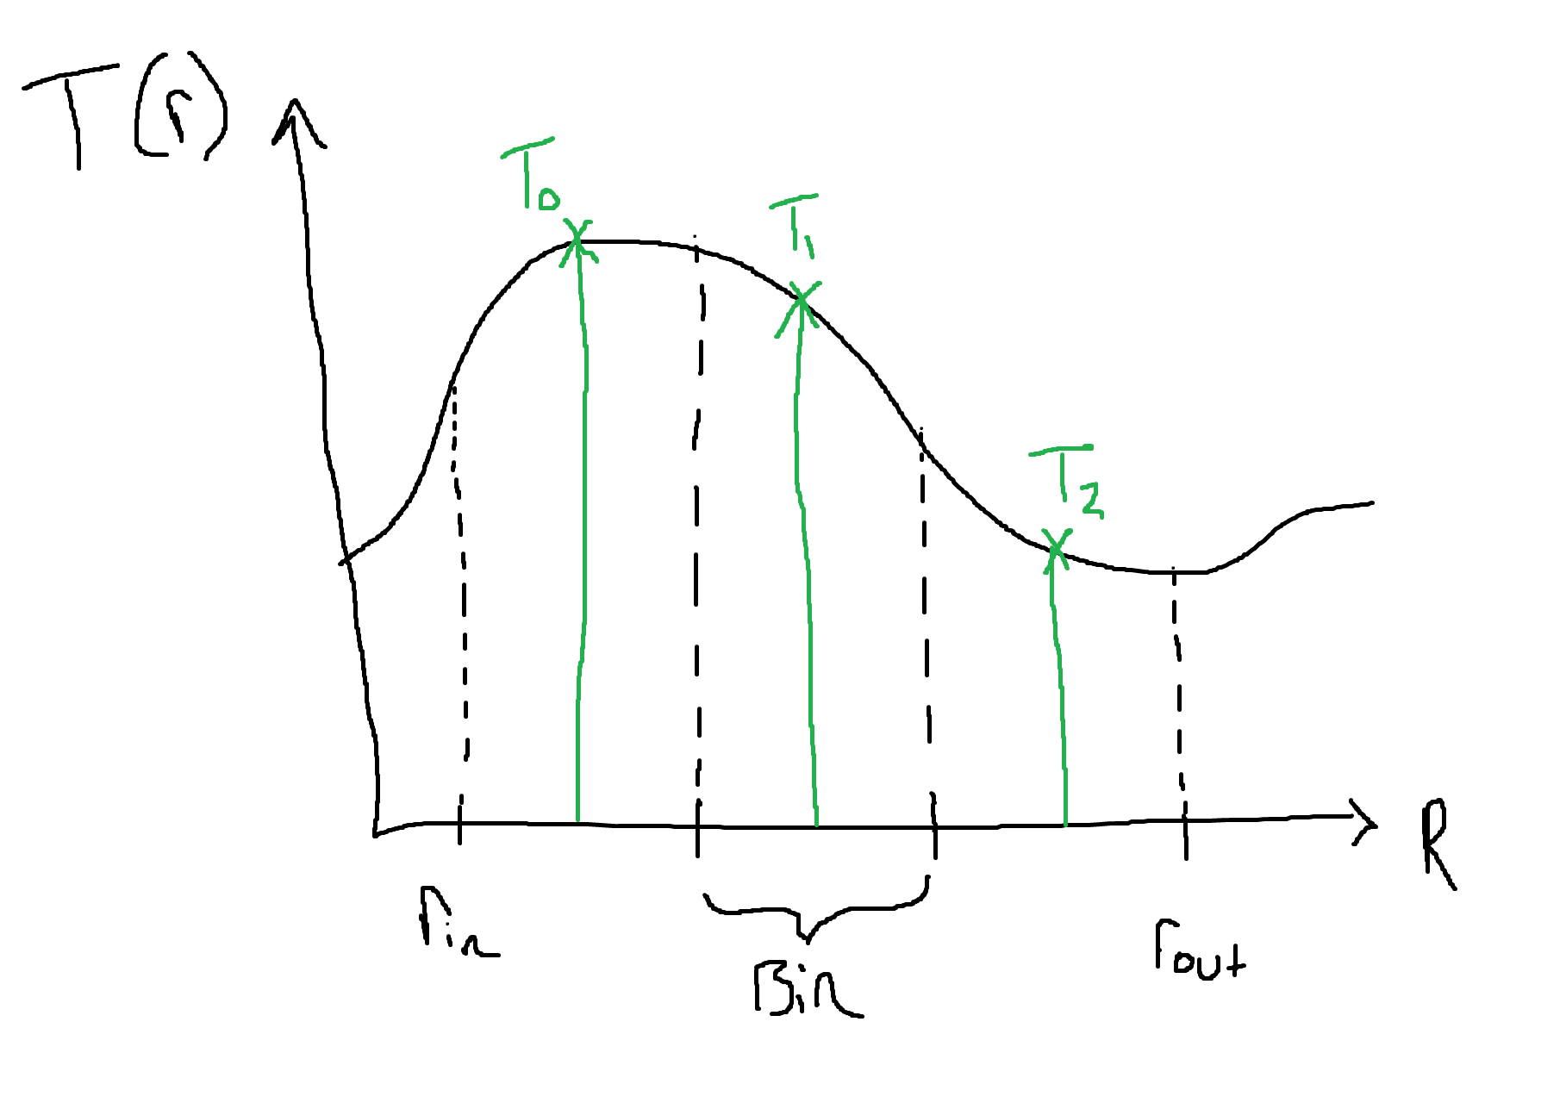
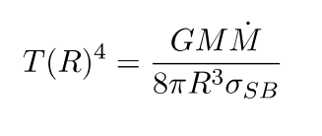
Implemented (non-viscous) temperature function

Slide 2
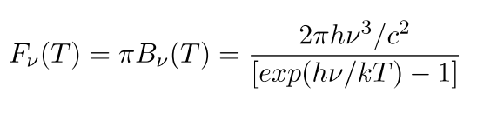
Implemented black body function

Slide 3
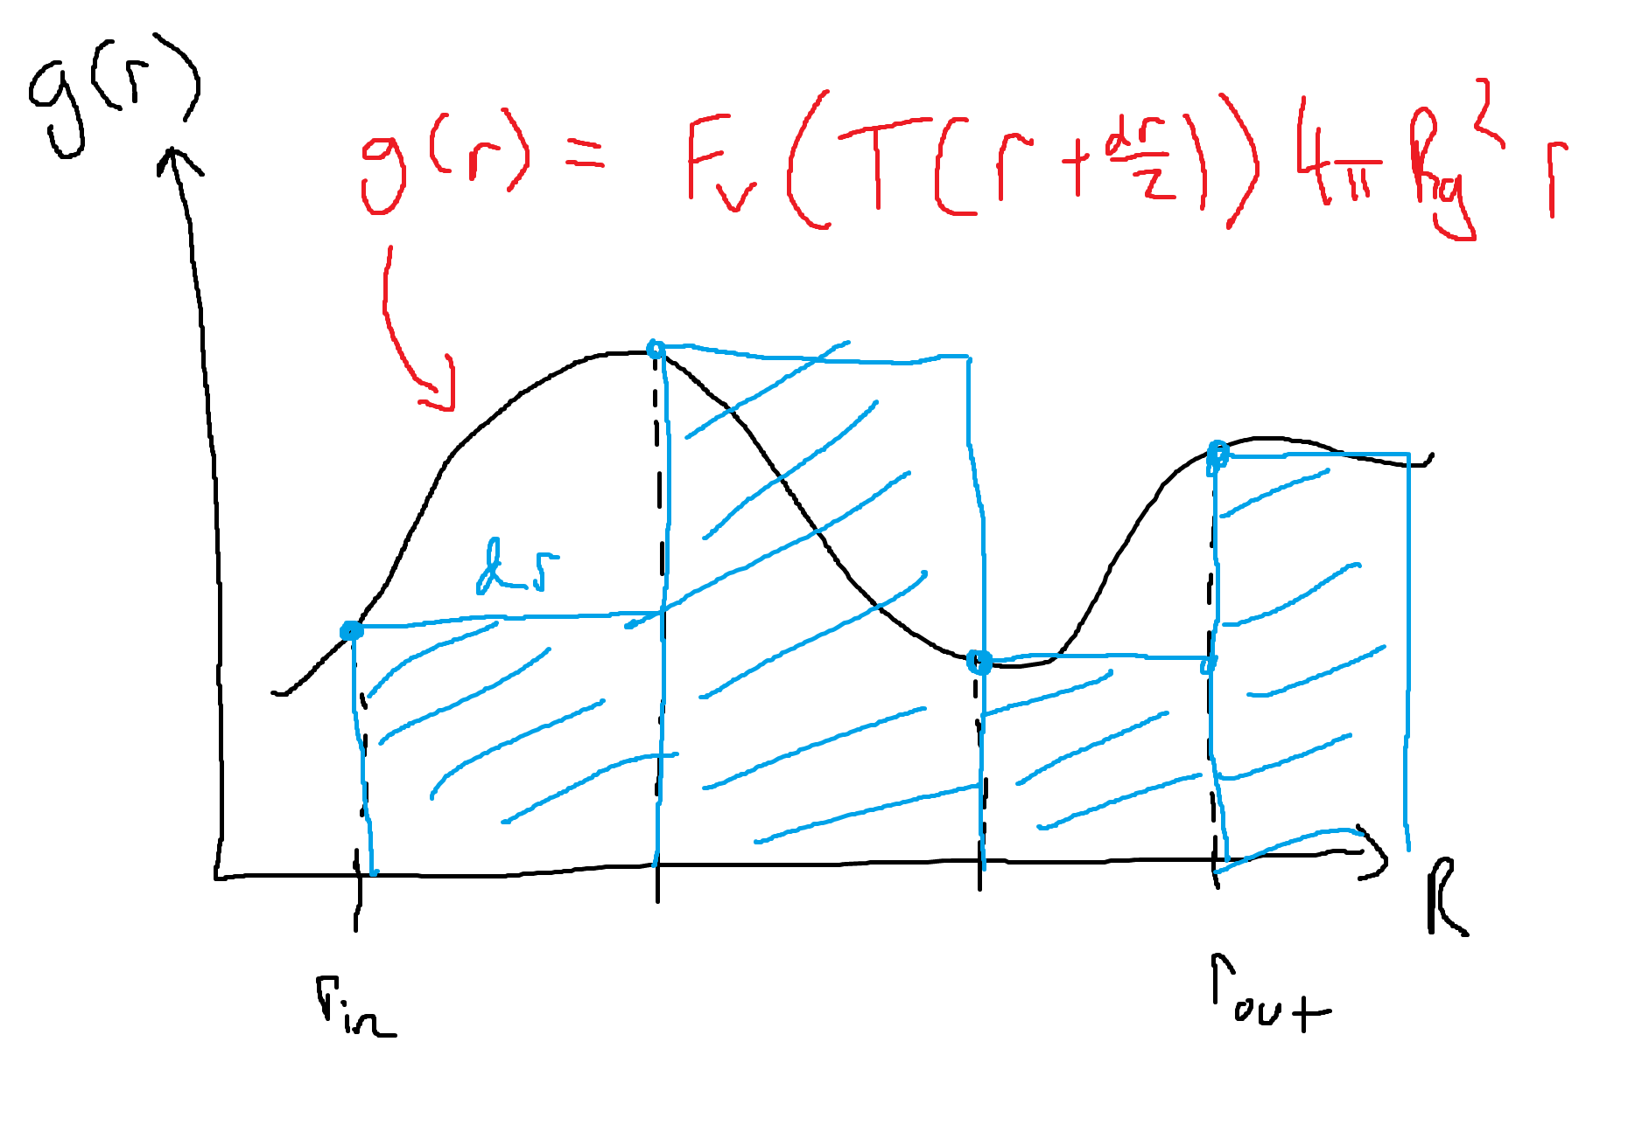
Implemented simple integrator for obtaining intensities

Slide 4
















What does doing the integral on a logarithmic grid look like?

Slide 5
Targets for next meeting
Perform the integral on a logarithmic grid, giving us L(v), and plot it as requested.
Integrate the spectrum L(v) to obtain the target value for total luminosity of 7e30 Watts.
Use more advanced integration method for less error (Simpson, RK4?).

